Slide 1


Manufacturing Defect Analysis
A data-driven investigation into defect patterns, repair costs, inspection methods, and severity breakdowns — designed to help manufacturing engineers and data analysts uncover actionable insights from production quality data.
DATA ANALYSIS
QUALITY CONTROL
MANUFACTURING INTELLIGENCE

Slide 2
Project Overview
Why Analyze Manufacturing Defects?
Every defect on a production line represents a cost — in materials, labor, time, and customer trust. This project applies systematic data analysis to a real-world manufacturing defects dataset, transforming raw inspection records into clear patterns that drive smarter decisions on the floor.
Detect Patterns
Quantify Costs
Identify which defect types occur most frequently and where they cluster across products and locations.
Analyze repair cost distributions to prioritize high-impact defect categories for process improvement.
Optimize Inspections
Reduce Severity
Evaluate which inspection methods catch which defects most effectively to refine quality protocols.
Map severity levels against product lines to focus resources on the most critical failure modes.

Slide 3
Dataset
What the Data Contains
The analysis is built on a structured manufacturing defects dataset. Each record captures a single defect event, providing a comprehensive view of what went wrong, where, when, and at what cost. The dataset supports multi-dimensional analysis across time, product, location, and severity.
Defect ID
Unique identifier for each recorded defect event
Product ID
Links the defect to a specific product or SKU in the production line
Defect Type
Categorizes the failure — Structural, Functional, or Cosmetic
Defect Date
Timestamp enabling time-series and trend analysis
Defect Location
Physical location on the product where the defect was found
Severity
Ranking of defect criticality from minor to critical
Inspection Method
Technique used to detect the defect (visual, automated, etc.)
Repair Cost
Monetary cost to remediate the defect, used for financial impact analysis

Slide 4



Defect Distribution
Three Dominant Defect Categories
Across the dataset, defects cluster into three primary categories. Structural defects involve integrity failures in the product frame or chassis. Functional defects affect operational performance — components that don't work as specified. Cosmetic defects are surface-level issues that don't impair function but impact customer perception and return rates.
Understanding the relative frequency of each type is the first step in allocating inspection resources and setting quality thresholds. Structural defects, while often less frequent, tend to carry the highest repair costs and severity ratings.
Defect type distribution is a key input for root cause analysis and process control prioritization.
Structural
Functional
Cosmetic
Frame, chassis, and material integrity failures
Operational and performance-related failures
Surface, finish, and appearance issues

Slide 5
Cost Analysis
Repair Cost Trends & Financial Impact
Repair cost is one of the most actionable metrics in defect analysis. By examining cost distributions across defect types, severity levels, and time periods, teams can quantify the financial burden of quality failures and build a business case for targeted process improvements. Summary statistics — mean, median, and range — reveal whether a few extreme outliers are skewing costs or if high expenses are systemic.
$2.4K
$890
Avg. Repair Cost
Median Cost
Mean cost per defect event across all categories
Midpoint value, less sensitive to high-cost outliers
3.2x
18%
Cost Multiplier
High-Cost Share
Structural defects cost over 3× more than cosmetic on average
Proportion of defects exceeding the 90th percentile cost threshold

Slide 6
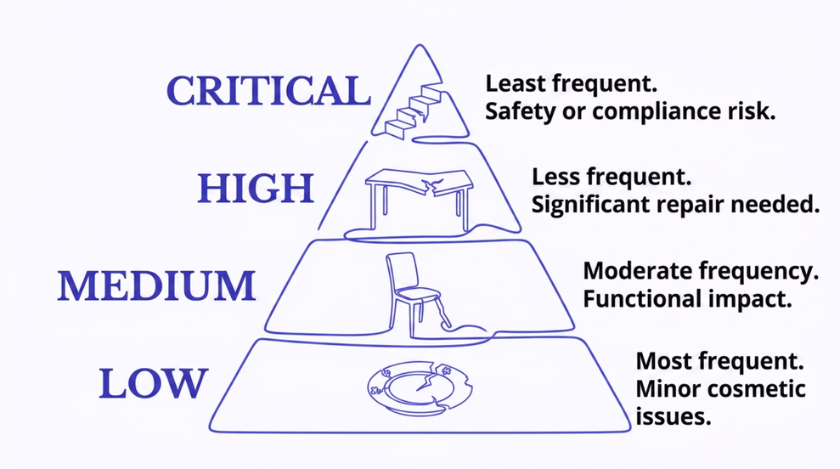

Severity Breakdown
How Critical Are These Defects?
Severity classification transforms raw defect counts into a prioritized action list. The dataset typically uses a four-tier scale — Low, Medium, High, and Critical — enabling teams to distinguish between nuisance issues and failures that pose safety or compliance risks.
Plotting severity against product IDs reveals whether certain products are disproportionately affected by high-severity defects, signaling potential design or supplier quality issues that require escalation beyond the production floor.
Critical-severity defects should trigger immediate root cause investigation and corrective action protocols.

Slide 7




Inspection Methods
Which Methods Catch Which Defects?
Not all inspection methods are equally effective across defect types. Visual inspections are fast and low-cost but may miss internal structural flaws. Automated sensor-based methods excel at detecting dimensional anomalies. Manual testing catches functional failures that other methods miss. Analyzing detection rates by method helps optimize the inspection mix and reduce escape rates.
Visual Inspection
Automated Sensing
Human-led examination best suited for cosmetic and surface-level defects. Fast and flexible but subject to inspector fatigue and variability.
Machine vision and sensor arrays detect dimensional and structural anomalies with high repeatability. Ideal for high-volume lines.
Functional Testing
Manual Sampling
Operational tests that verify product performance under load or simulated use. Catches functional defects other methods miss.
Statistical sampling protocols applied at key process checkpoints. Balances coverage with inspection cost in lower-risk stages.

Slide 8


Pattern Discovery
Product ID & Defect Relationships
Plotting defect frequency and severity against Product ID is one of the most powerful pattern-discovery techniques in this analysis. When certain products consistently show higher defect rates or cluster toward higher severity, it points to systemic issues — whether in design tolerances, supplier materials, or assembly procedures specific to that product line.
Scatter plots and heatmaps reveal correlations that summary statistics alone would miss. Products with both high frequency and high severity represent the highest-priority targets for engineering intervention and process redesign.
High Frequency + High Severity
Immediate engineering review required
High Frequency + Low Severity
Process optimization opportunity
Low Frequency + High Severity
Root cause investigation priority

Slide 9

Key Insights
What the Data Tells Us
Across defect types, cost distributions, inspection methods, and severity levels, several consistent patterns emerge from the analysis. These findings provide a clear roadmap for quality improvement initiatives and resource allocation decisions on the manufacturing floor.
1
2
Structural Defects Drive Cost
Inspection Method Gaps Exist
Despite lower frequency than cosmetic defects, structural failures account for the largest share of total repair expenditure — making them the highest-leverage target for prevention programs.
Certain defect types show low detection rates under current inspection protocols, indicating opportunities to augment visual checks with automated or functional testing methods.
3
4
Product-Level Clustering Is Real
Severity Skews Toward Critical
Specific Product IDs consistently correlate with higher severity ratings, suggesting design or supplier issues that require cross-functional resolution beyond the production team.
A meaningful proportion of defects fall into the High and Critical severity bands, underscoring the importance of early-stage detection and preventive quality controls.

Slide 10

Getting Started
How to Run This Analysis
This project is structured as a Jupyter Notebook, making it easy to reproduce, extend, and share. Follow these steps to get the analysis running in your own environment — whether locally or in the cloud.
Open Notebook
Run Cells
Execute all cells in order
Launch in Jupyter or Colab
Review Results
Place Dataset
Put data file in working directory
Check charts and summary outputs
The notebook is designed for exploratory analysis and visualization. Each cell builds on the previous one, so running in sequence is important. The assets/ folder contains supporting visual outputs including defect-type charts, repair cost trend plots, and severity scatter diagrams.
Project Files
Recommended Tools
Manufacturing_data.ipynb — Main analysis notebook
README.md — Documentation and setup guide
assets/ — Charts, visuals, and demo files
Jupyter Notebook — Local execution with full Python environment
Google Colab — Cloud-based, no setup required
Pandas + Matplotlib/Seaborn — Core libraries for data manipulation and visualization

